Slide 1
VIKAS GROUP OF INSTUTIONS GROCERY SALES FORECASTING
Y.GOWTHAMI ( 209T1A0588)
I.SIVA KISHORE KUMAR (209T1A0536)
INTERNAL GUIDE K.VEERA KRISHNAM RAJU(209T1A0547)
CH.SUNEETHA N.DEEPTHI REDDY(209T1A0561)
B.NARESH(209T1A0509)

Slide 2
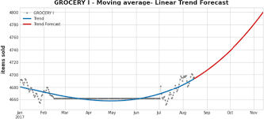
ABSTRACT
Predicting grocery sales is crucial for optimizing inventory management, ensuring product availability, and enhancing overall business profitability. This study proposes a data-driven approach to grocery sales prediction, leveraging advanced machine learning techniques. The aim is to develop accurate and reliable models that can forecast future sales based on historical data and relevant features.

Slide 3
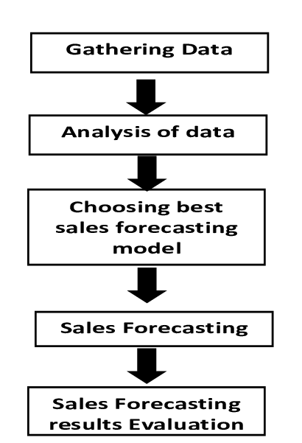
EXISTING SYSTEM
In traditional systems may be limited to basic sales figures without incorporating additional relevant features that could significantly impact sales patterns. Feature engineering in traditional systems is often rudimentary, if existent at all, lacking the sophistication needed to extract meaningful insights from the data.
DRAWBACLKS:
Limited Accuracy
Inadequate Data Utilization
Lack of Advanced Techniques
Poor Feature Engineering
Limited Validation and Testing

Slide 4
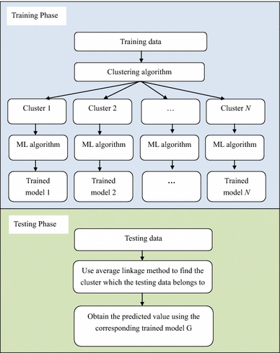
PROPOSED SYSTEM
The proposed system for grocery sales prediction aims
to address the limitations of the existing system by
leveraging advanced machine learning techniques and
comprehensive data analysis.
ADVANTAGES
Improved prediction accuracy
Better utilization of data
Enhanced adaptability
Optimize inventory management
Improve decision making
Cost saving

Slide 5
SYSTEM ANALYSIS
SOFTWARE REQUIREMENTS HARDWARE REQUIREMENTS
Operating System : Windows Family Processor : intel i5
Version : Python 3.9.1 Speed : 1.1 GHz (min)
Programming Language : Python RAM : 16GB RAM
Development IDE : JuPyter lab Hard Disk : 512

Slide 6
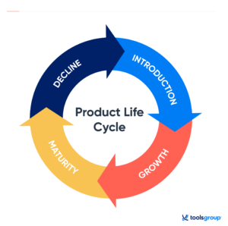
Project life cycle
Understanding Business Objectives
Data Collection
Data Preprocessing
Exploratory Data Analysis (EDA)
Model Selection
Model Training
Model Evaluation
Forecasting
Model Deployment
Monitoring and Maintenance

Slide 7
MODULE DESCRIPTION
1.NUMPY:
NumPy library can be used for various tasks such as data manipulation, statistical analysis, and mathematical computations.
2.PANDAS:
The pandas library is extensively used in grocery sales forecasting projects due to its powerful data manipulation and analysis capabilities, particularly for tabular data.
3.MATPLOTLIB:
Matplotlib can be utilized for various visualization tasks to help understand the data, analyze trends, and present forecasts.
4.SEABORN:
Seaborn can be utilized in a grocery sales forecasting project to visualize and analyze various aspects of the data, aiding in understanding patterns, trends, and relationships that can be valuable for forecasting.
5.PLYPLOT:
Matplotlib's pyplot module can be incredibly useful for visualizing various aspects of the data, model results, and forecasted trends.

Slide 8
Data set and TECHNOLOGY
DATA SET DETAILS
Start by exploring the Kaggle Datasets platform (https://www.kaggle.com/datasets). Use relevant keywords such as "grocery sales," "retail," or "supermarket" to search for existing datasets related to grocery sales forecasting or retail analytics.
TECHNOLOGY USED
Python is an interpreted high-level programming language for general-purpose programming. Created by Guido van Rossum and first released in 1991. It supports multiple programming paradigms including object-oriented, imperative, functional and procedural, and has a large and comprehensive standard library.
Machine learning is employed in predictive analytics projects to forecast future trends and behaviors based on historical data. This includes sales forecasting, demand forecasting, financial forecasting, churn prediction, risk assessment, and predictive maintenance.

Slide 9
Data sets sizes
Holidays_events : 22kb
Items : 100kb
Oil : 21kb
Sample_submission : 39,498kb
Stores : 2kb
Test : 1,23,207kb
Train : 48,80,325kb
Transctions : 1,517kb

Slide 10
DATA PREPROCESSING
1.Loading datasets
(train, test, stores, transactions, oil, holidays).
2.Data type conversions and date-time processing.
Decompose the time series data into its constituent components (trend, seasonality, and residual) . This helps in understanding the underlying patterns and extracting features that can improve forecasting accuracy.
3.Handling missing values and outliers.
Identify missing values in the dataset and decide on appropriate strategies for handling them
4.Exploratory Data Analysis (EDA)
To understand the dataset's structure and characteristics.

Slide 11
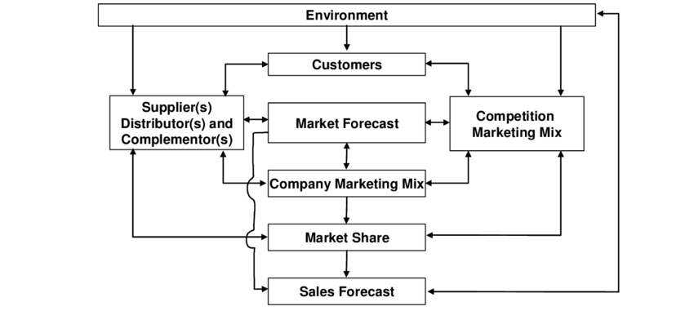
BLOCK DIAGRAM

Slide 12
REGRESSION
Predictive Modeling: Regression techniques can be utilized to build models that predict future sales based on historical data and other relevant features.
Linear Regression: This is a straightforward approach where sales are predicted as a linear combination of predictor variables. It assumes a linear relationship between the predictors and the target variable.
Ridge Regression and Lasso Regression: These are regularized versions of linear regression that can handle multicollinearity and prevent overfitting by penalizing large coefficients.
Gradient Boosting Regressor: This is an ensemble technique that builds multiple decision trees sequentially, where each tree corrects the errors of the previous one.
Random Forest Regressor: Another ensemble method that builds multiple decision trees and averages their predictions. It's robust to outliers and noise in the data.

Slide 13
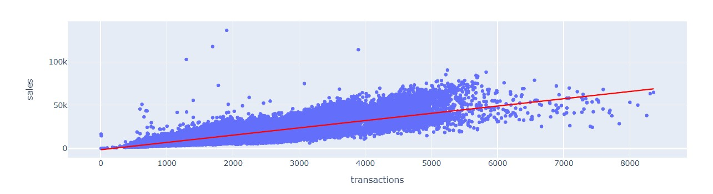
REGRESSION LINE

Slide 14
IMPLEMENTATION
Clustering can be a valuable technique in a grocery sales project using machine learning for various purposes such as customer segmentation, product categorization, and market basket analysis
Customer Segmentation
Product Categorization
Store Segmentation
Forecasting and Demand Prediction

Slide 15
CLUSTERING
1.CUSTOMER SEGMENTATION:
Clustering algorithms can be used to segment customers based on their purchasing behavior. By identifying distinct customer segments, retailers can tailor their marketing strategies, promotions, and product offerings to better meet the needs and preferences of each segment.
2.PRODUCT SEGMENTATION:
Clustering can also be applied to group similar products or items based on sales patterns. This can help retailers understand which products are typically purchased together or which products exhibit similar demand patterns over time.
3.STORE SEGMENTATION:
Clustering algorithms can be used to group similar stores or locations based on sales performance, geographic location, demographics, or other relevant factors.
4.DEMAND FORECASTING:
Clustering can be incorporated into demand forecasting models to improve accuracy

Slide 16
CORRELATION
Assessing Correlation between Sales and Transactions:
The project calculates the Spearman correlation between total sales and transactions.
Correlation with Daily Oil Prices:
the Spearman correlation between daily oil prices and sales, the project aims to determine whether there's any association between them.
Correlation between Sales and Oil Prices for Different Product Families:
it calculates the Spearman correlation individually for each product family to understand if the relationship between sales and oil prices varies across different types of products.
Assessing Correlations among Stores:
This can help identify similarities or differences in sales patterns between different stores.

Slide 17
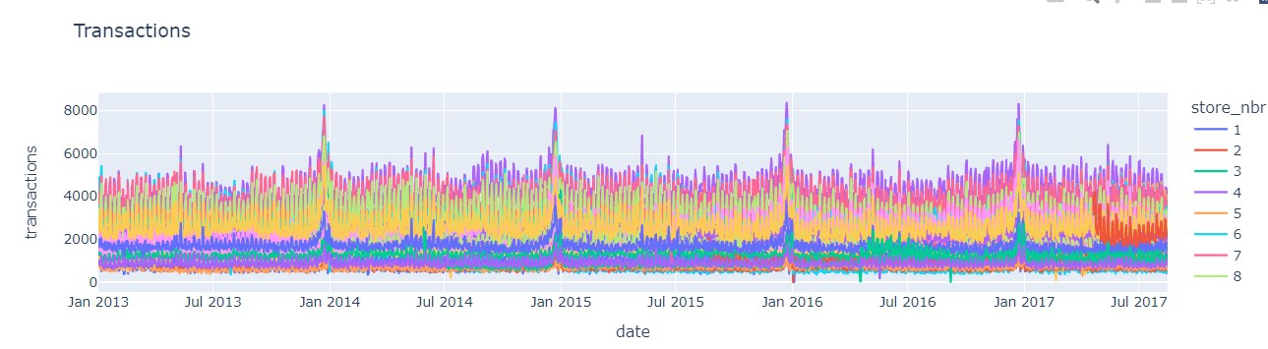
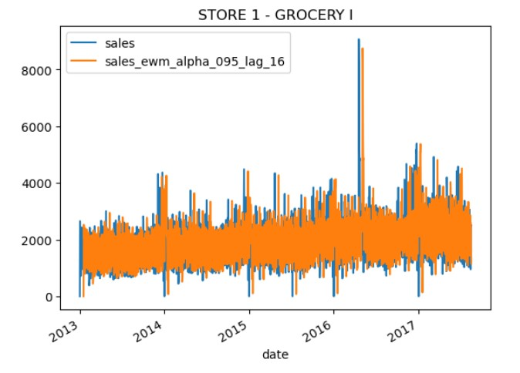
results

Slide 18
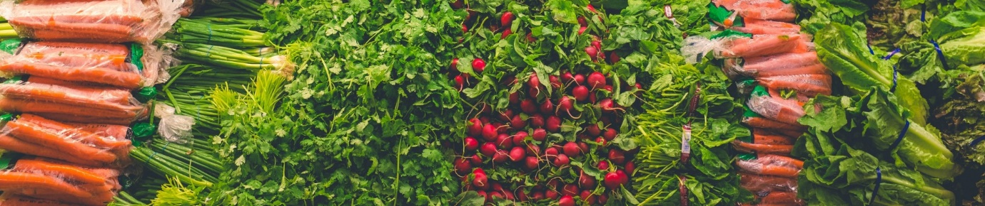
future scope
The future scope for a grocery sales forecasting project using advanced machine learning techniques is vast and promising.
Integration of Real-Time Data
Enhanced Feature Engineering
Model Ensemble Techniques
Deployment of Cloud-Based Solutions
Adoption of Advanced AI Techniques

Slide 19
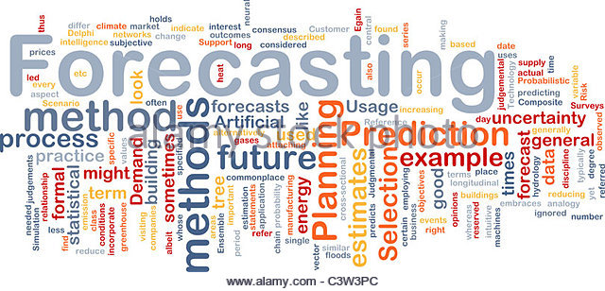
conclusion
In conclusion, developing accurate and reliable models for grocery sales forecasting is essential for optimizing inventory management, ensuring product availability, and ultimately maximizing business profitability. Through a data-driven approach, leveraging advanced machine learning techniques, businesses can harness historical sales data and relevant features to predict future sales with precision.

Slide 20
thankyou

